Slide 1
INTRODUCTION
Page Play
Table of Contents
Carnegie Mellon Offensive Philosophy
Offense at Carnegie Mellon
The First Digit
Shifting of Formations
The Second and Third Digit
Extended Motion
Phrase Following the Play Number
Phrase Identifying Counters
Huddle and Cadence
Defensive Techniques
Goal Line and Short Yardage
Glossary
Glossary
Glossary

Slide 2
Carnegie Mellon Offensive Philosophy
We have made an effort to simplify your offense yet still confront the defense with multiple problems. This is accomplished by a relatively few basic plays which all have a counter, a pass, or an option as a complement. Most of our plays have at least two such complements. The use of several shifts, formations, motions or combinations of these, multiplies the problem for the defense with no change of assignments.
In spite of the fact that we have nine points of attack numbered, there are really only 3 attack areas: outside, off tackle, and up the middle. These may be hit directly or by countering. All 4 backs in this offense are ball carriers and are dependent on each other to carry out fakes and block.
Almost every play in our offense is established by blockers in at the hole and out at the hole creating a running alley. The last digit of the play number indicates not only the point of attack, but the player who blocks down if spacing permits. If spacing does not permit this block, the play moves inside one man via your rule assignments.
We feel when we incorporate our play action pass attack from every formation, our true sprint out attack, our run and shoot attack, and our semi-dropback attack, we can hit every area of the defense without predictability.
Our shotgun and spread formation attack has allowed us to put additional pressures on the defense without changing rules, assignments, landmarks and mesh points for most of our plays!
The basic concept is to create conflicts in the defense and individual defensive personnel without us having to change anything!
LET’S HAVE FUN...SCORE POINTS...AND WIN!!!

Slide 3
Offense at Carnegie Mellon
The advantage of offense over defense is knowing from what formation, how and where the play will attack, and when the ball will be put in play. This, of course, requires a numbering system which clearly communicates an entire play simply and quickly.
The signal system used by the "Carnegie Mellon Wing-T" to communicate information necessary for a play to be executed is combined into a three-digit numbering scheme. These three-digit play numbers may be preceded by a term altering the formation and will be suffixed by a term identifying the series action and blocking scheme.
The first number indicates the formation. A color (Red, Blue, White), or a descriptive term (Rip, Liz, Gun), or a combination may be used. The second number indicates the ball carrier. The third number indicates the point of attack. The following is an example of this three-digit system. In essence this means 600 formation, 2 back at the 8 hole with buck sweep blocking and techniques."Flip to" moves the tight end from the left to the right.
Alteration of Point of Series Action &
Formation Formation Ball Carrier Attack Blocking Scheme
Flip to 6 2 8 Buck Sweep

Slide 4
The First Digit
There are several formations in the "Carnegie Mellon Wing-T" and they are always described by the first of three digits or by a word. The end automatically spreads away from the wing or flanker unless specifically requested to modify his position. The normal width of the spread end is 17yds from the ball. The wing is 2yds outside of the TE and 2 yds from the back tip of the ball. The guard and tackle are normally spaced 2 feet apart while the tight end is spaced 3 feet. The TE may widen his split to 6 feet if the tackle is uncovered. The guard may widen to 3 feet if he is covered and the center is uncovered. The fullback's toes are 4 yards from the ball. The diveback is parallel with the fullback and his outside foot is outside the tackle's outside foot. These positions could be altered depending on the play and the assignment. Certain plays in Red and Blue formation requires the fullback depth at 5 yds. The slot should take his alignment from the tackle with his outside foot 3.5yds from the tackle's outside foot. In shotgun, the toes of the QB are at 5 yds. and the toes of the FB are at 4.5yds from the ball.
2' 2' 2' 2' 3' 2yds
17 yds
2yds
4 yds
B
B
T
3'
T
3.5yds
6'
5yds
5yds
4.5yds

Slide 5
Shifting of Formations
We will usually line up in Red or Blue formation and then shift accordingly. From Red formation we will shift to 600 or 500. From Blue formation we will shift to 700 or 400. In Rip formation we can shift to Rip600 or Rip500 and from Liz formation we can shift to Liz700 or Liz400. All shifts will be done on the first Red-Set-Go.
RED
600
500
RIP
Rip600
Rip500

Slide 6
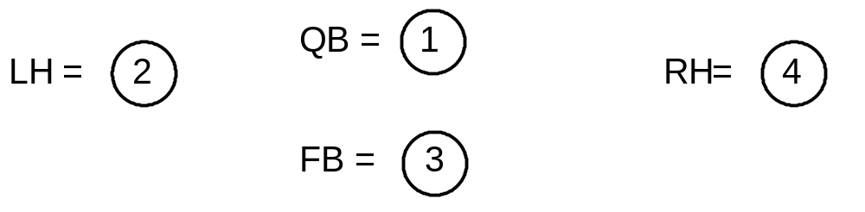
The Second and Third Digit
The second digit assigns the Ball Carrier. The backs are numbered as follows:
QB is #1- Left half is #2- Fullback is #3 - Right half is #4.
The Point of Attack
The third and last digit is the point of attack. There are nine points of attack. With the exception of the 2 flank areas, the holes are numbered over the seven offensive linemen. The last digit not only assigns the point of attack but assigns the man who is the original lead or wall off blocker and indicates the direction of flow of the backfield. With the third digit even, the direction of flow is to the right...odd indicates flow to the left.
9
7
5
3
1
0
2
4
6
8
ODD EVEN

Slide 7
Extended Motion
While we are committed to a three back attack, it will be advantageous to put a man in motion to force a secondary coverage problem. "Run To" tells the wing away from the play to go in flat motion in the direction of the play. "Run Away" tells the wing on the side of the play call to go in flat motion away from the direction of the play.
Red Run Away 31 Trap
Red Run To 36 Down

Slide 8
Phrase Following the Play Number
An expression following a play number indicates the blocking pattern we will use and the backfield series action. Some of our blocking patterns are: Trap; Down; Belly; Belly Slide; Blast; Jet Seep; Buck Sweep: Rocket Sweep; etc. Here are some examples:
630 TRAP 628 BUCK SWEEP
Red 28 JET SWEEP Red 28 ROCKET SWEEP
Red 35 BELLY SLIDE Red 36 DOWN

Slide 9
Phrase Identifying Counters
Normally the flow of the backs is toward the last digit. When a word (Counter, Joker, Scissors) is added to a play number, all backs but the ball carrier run away from the direction of the point of attack. 620 Belly Counter is an example. All backs are running toward the ODD side except the LH who is the ball carrier.
Here are some other examples:
Red 34 SLIDE JOKER Red 20 SCISSORS

Slide 10
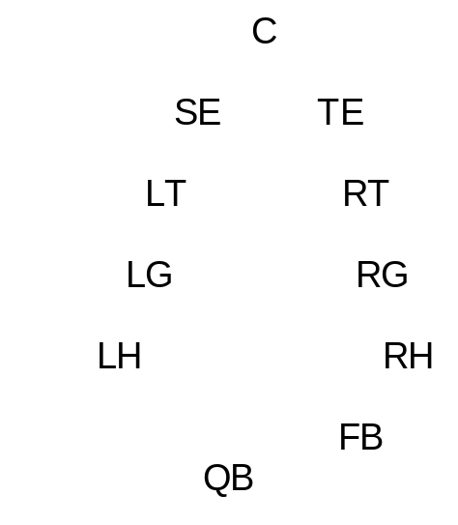
Huddle and Cadence
The use of a numbering system requires that the team be given the information in an organized manner that will prevent the opposition from hearing the signals. This requires a huddle. This is the huddle we will use with the quarterback facing the LOS and everyone else facing the quarterback. The center calls the huddle 7 yards from the ball. The quarterback calls "READY" and all eyes should be on him. The fullback is responsible to give the down and distance to the huddle at this time prior to the quarterback beginning the play call. Everyone should stand tall and watch the quarterback's mouth. After the first play call, the C-SE & TE leave. The snap count is repeated and everyone sprints to the line and gets set.
The cadence will be a combination of rhythmic---RED---SET-GO, and non-rhythmic. SET/GO should sound like one word with RED being short or long and the space between RED and SET/GO varied according to the play. We can go on the first sound, which will be RED, usually when we don't need motion or when running the JET SERIES. We can snap the ball on RED-SET particularly for the Belly Slide series. We can snap the ball on the second Red after a shift. If motion is not inherent in the play the QB will initiate with a nod to the appropriate back. We can go on a long 1 which would be a color, number, then RED-SET-GO. Blue 28- RED---SET/GO. Through the "live color system", we can change the play by calling the live color; then the next number will be the play call. We will determine weekly by game plan what the blocking scheme and/or pattern will be.

Slide 11
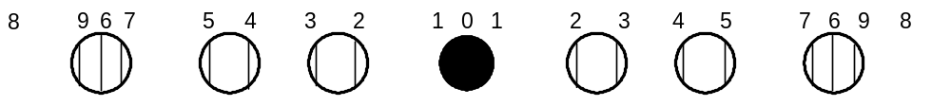
Defensive Techniques
In order to facilitate communication between players and coaches, we will assign numbers to the techniques over each offensive lineman.
CENTER - Head up is "0" technique
- shade either side is "1" technique
GUARDS - Inside shoulder is "2" technique
- outside is "3" technique
TACKLES - Inside shoulder is "4“ technique
- outside is "5" technique
TIGHT ENDS - Head up is "6" technique
- inside shoulder is "7" technique
outside is "9" technique
anything wider is an "8" technique

Slide 12
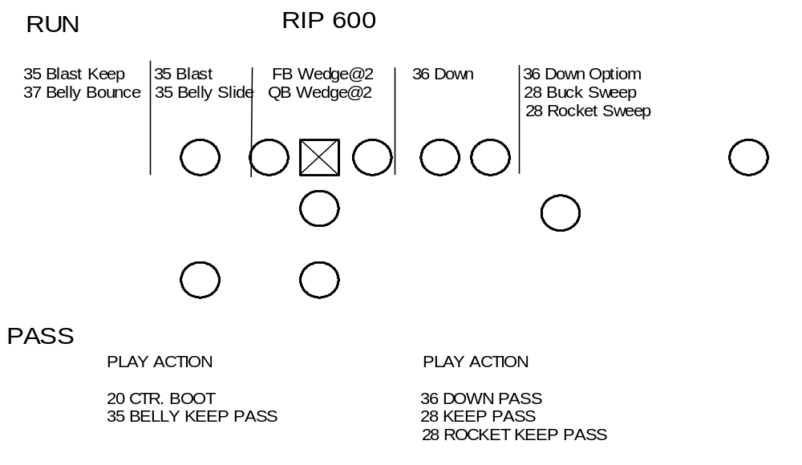
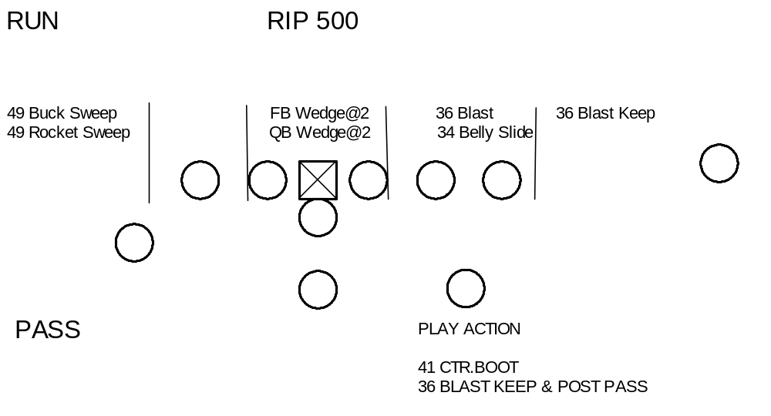
Goal Line and Short Yardage
Our Goal Line and Short Yardage offense will be run from Rip and Liz formations. We will use our field plays but we will be able to hit the width and depth of the field. It is critical to make yards in these situations. We must not be offsides or have penalties! Let's not stop ourselves! When possible we should go on the first sound.

Slide 13
Glossary
AREA BLOCK-ZONE Blocking an area after taking one step forward-
Zone Principle.
ARROW PATTERN Usually slot or TE goes directly to the flat.
AWAY BLOCK Block seam away from point of attack.
BOOTLEG QB keeps ball in the opposite direction of play call
and usually executes run or pass option.
COUNTER Backs run opposite to the called play with the
exception of the ball carrier, who runs to the point of attack.
CUT OFF BLOCK Block downfield where you will intercept the
defender’s path to the ball carrier.
DOWN BLOCK Block first man inside.
DRAG A delayed pattern usually under the LB’s.
GAP BLOCK Block man in your inside seam. Be prepared to get
head in front.
GUT BLOCK Step around tail of adjacent lineman – wall off.
INSIDE-OUT BLOCK Pulling lineman blocks out on first free man at point
of attack…trap block.

Slide 14
Glossary
JET MOTION Flat, fast motion by wing or slot. Aim 2ft. behind QB.
KEEP PASS QB keeps the ball in direction of the offensive call
and usually executes run or pass option.
LEAD BLOCK The block that establishes an opening as in post-lead,
and allows blocker to come off for an LB.
LOG BLOCK Pull toward point of attack with depth, attempting to
Get head outside and hook defensive man. If he opens up, kick him out.
ODD BLOCK Backside adjustment of an on block for odd defense
Where guard blocks outside and tackle guts inside.
OPTION QB executes keep or pitch.
POST The inside block of a double team where the blocker
Protects his inside seam.
POST-LEAD BLOCK Double team.
REACH BLOCK Fire step @45 to get head outside and inside shoulder on outside # of defender.

Slide 15
Glossary
READ DOWN Step to block down, if defensive man on adjacent man
stunts away, climb and block backer.
ROCKET MOTION Full speed motion by wing/slot behind FB then flat to
sideline no deeper than 4.5yds.
SEAM Zone between 2 adjacent linemen.
SHUTOFF Type of block used when you are covering for a man
who has pulled.
SLIDE MOTION Also known as Canadian motion…wing or slot goes flat
behind QB and slides facing LOS.
STALK Block used mainly by wide receivers. Release off line
with speed to drive DB back. As he relinquishes his
cushion, come under control and maintain your
position between him and the ball carrier. Do not permit
him to support through you!
WAGGLE Bootleg play opposite the offensive call. Can be with or
without guards pulling.
WALL OFF BLOCK Block defensive pursuit immediately beyond line of
scrimmage.
WHAM Sucker blocking by wing vs. man reading center or
Guard.
ZONE Lineman stepping with playside foot at 45 degree angle
Try to block what shows with your inside shoulder
getting your head upfield.

