Slide 1
BLUE BELLY
PAGE PLAY
Table of Contents
Blue 20 Counter Boot
Blue 33 Wham
Blue 33 Wham Boot
Blue 34 Belly Slide
Blue 34 Belly Out Pass
Blue 34 Belly Post Pass
Blue 34 Belly Boot
Blue 34 Belly Dump Pass
Blue 35 Belly Slide
Blue 35 Belly Naked
Blue 35 Belly Keep Pass
Blue 41 Counter Boot
Blue 43 Slide Opposite

Slide 2
PLAY
Blue 20 Counter Boot
SS
FS
C
B
B
B
C
E
T
N
E
43 def
LT
: On-Area-Pull away.
LG
: Area-Post
OC
: Post-Lead
RG
: Gap-On-Lead
RT
: Gap-On-Area-Hinge
TE
: Release INSIDE. Post/Corner route. Comeback 17-15.
SE
: Crossing pattern 9-12 yds deep.
QB
: Reverse pivot short of midline. 2nd step @45 over midline. Put ball on outside hip extending inside
arm on 3rd step faking Belly Ctr. Look back 2 steps. Attack Flank. Run 1st. Look deep to TE/then FB.
LH
: Fake Belly Ctr. Rock out, drop step, lateral crossover, aim for Center.From wing run thru your diveback
position.
RH
: Early motion. 2 step slide in PST area. Hook 1st outside of PST.
FB
:1st step crossover aim for outside foot of PSG. Run thru and block B gap if threatened. Get into flat area
5-6 yds. deep.
TECHNIQUES:

Slide 3
PLAY
Blue 33 Wham
FS
SS
C
B
B
B
C
E
T
N
T
43
TE
:On- Area
FS
LT
:On-Area
C
B
B
B
C
E
T
T
E
B
LG
:1st Backer from C
OC
:Away-1st Backer Left
44 def
RG
:On-Away
RT
:On-Away
SS
FS
SE
:Crossfield-Block back @ hole
C
B
T
B
N
B
T
B
C
QB
:Reverse pivot-Quick Belly-Boot
LH
:Inside motion-Block 1st DL on or inside RG
34 def
RH
:Crossfield- Block Across hole
FB
:Ball Carrier- Lateral step, Croosover 45 for B gap
FS
TECHNIQUES:
C
B
B
B
SS
C
SS
T
N
T
33 def
Video

Slide 4
PLAY
Blue 33 Wham Boot
SS
FS
C
B
B
B
C
E
T
N
T
43 def
LT
: On-Area-Hinge.
LG
: Pull left. Log C Gap Area..
OC
: On-Away.
RG
: Gap-On-Area.
RT
: Gap-On-Area.
TE
: Drag Pattern 10-12yds.deep.
SE
: Run a deep flag pattern. Sell the crossfield block.
QB
: Reverse pivot. Quick Belly, fake wham. Boot to SE. Look deep to flag.
Pick up 3 levels.
LH
: Inside motion.Block 1st DL on or inside RG. Responsible for off B area.
RH
: Slam 1st DL inside. Wheel and run arrow to flat 5-6yds.deep.
FB
:Fake wham. Block B gap area.1st LB backside.
TECHNIQUES:

Slide 5
PLAY
Blue 34 Belly Slide
SS
FS
C
B
B
B
C
E
T
N
T
43 def
TE
:Zone. Step & Hinge vs.50.
C
FS
LT
:Zone. vs. 5 tech:Zone. vs. 4 tech:odd block.
B
B
B
B
C
E
T
T
E
LG
:Zone. vs. 3 tech:Zone. vs. 4 tech: odd block. vs.
2tech: Gut.
OC
:On-Away. Whammy 2 tech.
44 def
RG
:Gap-On-Lead. Whammy 2 tech.
SS
FS
RT
:Gap-Down-On.
C
B
B
C
SE
:Fake Crack. Downfield. Blocl up @hole.
B
T
N
T
B
QB
: Reverse pivot deep over midline- 2nd step @45-
3rd step even w/FB, cross behind allowing for cutback.
Set up for Belly Pass behing PST.
34 def
LH
:.Jet motion. Slide 2 steps sideways @QB area.
Block 1st LB from C.
FS
RH
:.Step out. Block 1st outside PST.
C
B
B
SS
C
FB
:Ball Carrier. Lead step, Crossover, Square. Bend
SS
B
T
N
T
path for inside foot of PST.
TECHNIQUES:
33 def
Video

Slide 6
PLAY
Blue 34 Belly Out Pass
SS
FS
C
B
B
B
C
E
T
N
T
43 def
LT
:On-Hinge
LG
:On-Hinge
OC
:On-Hinge. Whammy vs.2 tech.
RG
:Gap-On-Lead. Whammy vs. 2 tech.
RT
:Gap-Down-On
TE
:Check Release. Run a fly on the hash. Control safety. Read 1st LB inside. If he blitzes, stay in. When
in doubt, Don't Go Out.
SE
:Out Pattern. 14-12yds.
QB
:Reverse pivot deep over midline. Fake Belly w/quick poke to FB. 3 step drop after fake. Set up
behind PST. Look deep to Out/Flag/Flat.
LH
:Belly slide motion. You have B gap blitz. Delayed into flat.
RH
:Step out as if blocking #4. Run a Flag route.
FB
:Belly path with hard fake. You have first outside PST.
TECHNIQUES:

Slide 7
PLAY
Blue 34 Belly Post Pass
SS
FS
C
B
B
B
C
E
T
N
T
43 def
LT
: On-Hinge
LG
: On-Hinge
OC
: On-Hinge. Whammy vs.2 tech.
RG
: Gap-On-Lead. Whammy vs. 2 tech.
RT
: Gap-Area-On
TE
: Check Release. Run a fly on the hash. Control safety. Read 1st LB
inside. If he blitzes, stay in. When in doubt, Don't Go Out.
SE
: Post pattern. Stay away from backside safety. If covered deep raise hand
and curl at 18 yds.
QB
: Reverse pivot deep over midline. Fake Belly w/quick poke to FB. 3 step
drop after fake. Set up behind PST. Look deep to Post/Sail/Flat.
LH
: Belly slide motion. You have B gap blitz. Delayed into flat.
RH
:Step out as if blocking #4. Run a go route to a sail.
FB
: Belly path with hard fake. You have first outside PST.
Video
TECHNIQUES:

Slide 8
PLAY
Blue 34 Belly Boot
SS
FS
C
B
B
B
C
E
T
N
T
43 def
LT
:Gap-On-Area.
LG
:Gap-On-Area.
OC
:On-Away.
RG
:Pull: take over TE's man. Lead QB.
RT
:Gap-On-Area.
TE
:Gap-On. Slam for 2 counts. Release to flat 4-5 yds. deep.
SE
:Post. Read opposite safety. We want a high/low w/ you and slot.
QB
:Reverse pivot. Fake Belly. Bootleg away. You must get your back turned.
LH
:Belly slide motion. You have B gap blitz.
RH
.Crossing pattern 12 yds. deep. We want a high/low w/you and TE.
FB
:Fake Belly. You have D Gap/edge blitz.
TECHNIQUES:

Slide 9
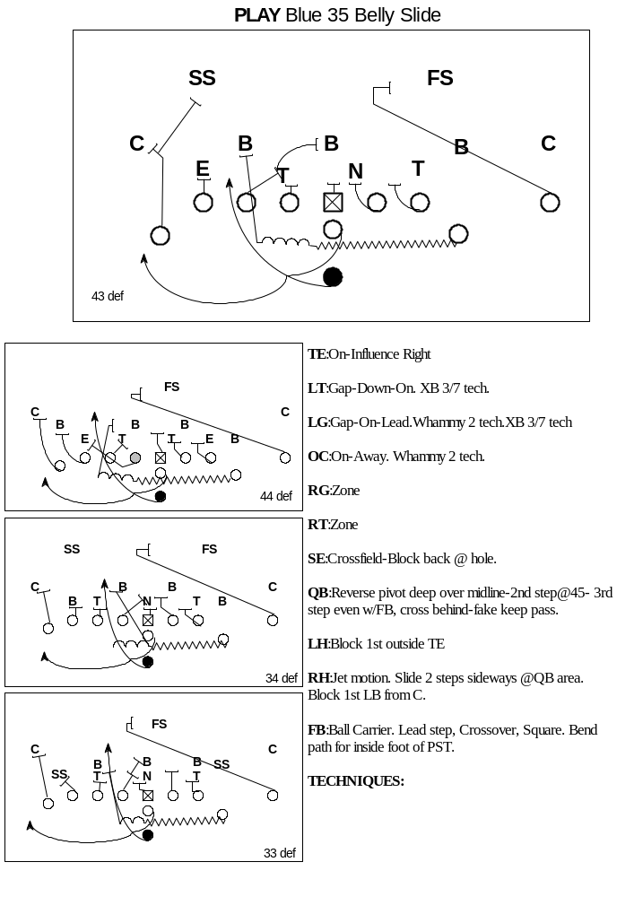
Video

Slide 10
PLAY
Blue 35 Belly Naked
SS
FS
C
B
B
B
C
E
T
N
E
43 def
LT
: Zone Away.
LG
: Zone Away.
OC
: Zone Away.
RG
: Zone Away.
RT
: Gap-On-Area: 1st Outside B Gap.
SE
: Run V-Pattern. Break off at 18 yards if covered deep.
TE
: Fire Step and run 10-12 yard drag.
QB
: Fake Belly. Boot away. Attack the flank. 3 level stretch.
RH
: Motion to B Gap. Attack outside foot of PSE. Be prepared to log 5/9 tech.
Slide into flat.
LH
: Fire Step and centerfield control
FB
: Fake Belly. Block D gap.
Video
TECHNIQUES:

Slide 11
PLAY
Blue 35 Belly Keep Pass
SS
FS
C
B
B
B
C
E
T
N
T
43 def
LT
:Gap-Down-On.
LG
:Gap-On-Lead
OC
:On-Hinge
RG
:On-Hinge
RT
:On-Hinge
TE
:Release inside.Bump Cgap blitz. Flag pattern. Comeback 17-15 if no TD.Switch w/wing vs.7tech.
SE
:Drag pattern. 10-12 yds. deep.
QB
:Reverse pivot deep over midline. Fake Belly w/quick poke to FB.Attack flank reading down block
of the wing. Look deep to TE picking up drag and arrow.
LH
:Block down on 1st man inside. Seal flank. Switch with TE vs. 7 tech.
RH
.Belly slide motion. Run arrow to flat.
FB
:Belly path w/hard fake. You have 1st LB playside/C gap area.
TECHNIQUES:

Slide 12
PLAY
Blue 41 Counter Boot
SS
FS
C
B
B
B
C
E
T
N
E
43 def
LT
: Step and Hinge.
LG
: Step and Hinge.
OC
: Post-Lead.
RG
: Area-Post.
RT
: Gap-On-Area.
TE
: Release INSIDE. Drag 10-12 yards.
SE
: Waggle Pattern. Post-Corner @ 15 yards. Break off at 18 yards if you
cannot beat deep defender.
QB
: Reverse pivot short of midline. 2nd step @45 over midline. Put ball on
outside hip extending inside arm on 3rd step faking Belly Ctr. Look back 2
steps. Attack Flank. Run 1st. Look deep first in 3 level stretch.
RH
: Fake 41 Slide Opposite Rock out, drop step, lateral crossover, aim for
Center.From wing run thru your diveback position.
LH
: Early motion. 2 step slide in PST area. Hook 1st outside of PST.
FB
: 1st step crossover aim for outside foot of PSG. Run thru and block B
gap if threatened. Get into flat area 5-6 yds. deep.
Video
TECHNIQUES:

Slide 13
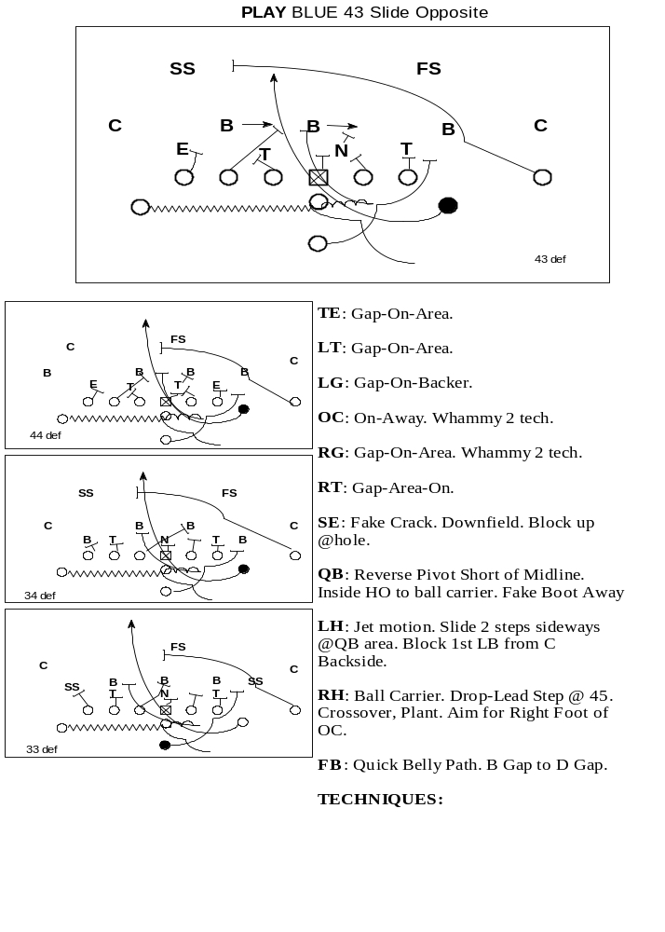
Video

