Slide 1
BLUE JETS
PAGE PLAY
Table of Contents
An Overview of Jet Sweep
Blue 24 Jet Lead
Blue 24 Jet XX
Blue 24 Jet XX Pass Right
Blue 28 Jet Sweep
Blue 28 Jet Keep Pass
Blue 28 Jet Waggle
Blue 30 Jet Trap
Blue 31 Jet Trap
Blue 31 Jet Sucker
Blue 31 Jet Handback Trap
Blue 37 Jet Down
Blue 45 Jet XX
Blue 45 Jet XX Keep
Blue 45 Jet XX Pass Left
Blue 45 Jet Lead
Blue 49 Jet Sweep
Blue Jet 49 Waggle
Blue Jet 28 Waggle Screen Right
Blue 49 Jet Reverse
Blue 49 Jet Reverse Keep
Blue Jet F8
Blue Jet Pass 2

Slide 2
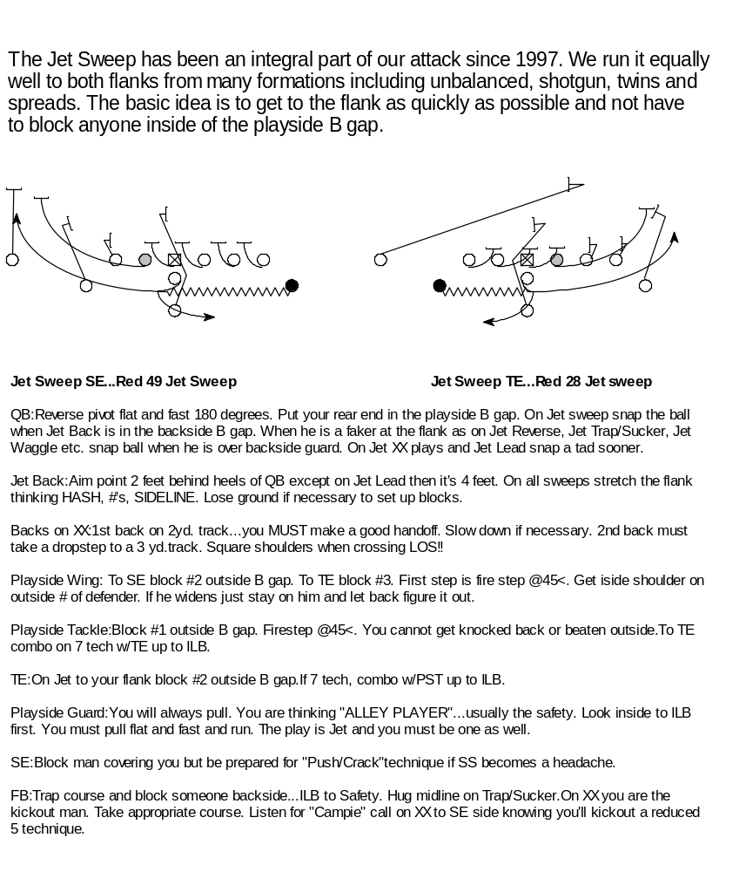
An Overview of Jet Sweep

Slide 3
PLAY
Blue 24 Jet Lead
SS
FS
C
B
B
B
C
E
T
N
T
43 def
TE
:Zone.
FS
RT
:Zone.
C
B
B
B
B
C
RG
:Zone.
E
T
T
E
OC
:On-Away. Whammy 2 tech.
44 def
LG
:Gap-On-Lead.Whammy 2 tech.
LT
:Gap-Down-On.
SS
FS
SE
:Fake Crack downfield.Block up @hole.
C
B
B
C
QB
:Reverse pivot deep on midline.HO to wing.Bootleg
B
T
N
T
B
away.Snap ball when Jet Back is over BST.
RH
:Ball Carrier.Jet motion.Aim pt. 4ft. behind QB.Lose
34 def
ground 1 yd. Square cut. Follow FB.
LH
:Step out. Block 1st outside PST.
FS
FB
:Lateral step. Crossover @45. Lead on 1st LB
C
C
playside B gap area.
SS
B
B
B
SS
TECHNIQUES:
T
N
T
33 def
Video

Slide 4
PLAY
Blue 24 Jet XX
SS
FS
C
B
B
B
C
E
T
N
T
43 def
TE
:Shutoff
FS
LT
:Pull- Lead thru hole. Head on swivel.
C
B
B
B
B
C
LG
:On-Area-Away
E
T
T
E
OC
:On-Area-Away
44 def
RG
:Gap-Post-Away
RT
:Gap-Lead-Backer-Influence.
SS
FS
SE
:Crossfield. Block up @hole.
C
B
B
B
C
QB
: Reverse pivot as on Jet sweep. Snap ball when slot
B
T
N
T
is @PST. Handoff to slot. Fake waggle. Be quick.
LH
:.Ball carrier. Drop step- you are on the 3 yd. track.
34 def
Receive inside HO from slot. Follow FB and BST.
RH
:.Jet motion.Receive handoff from QB. Give outside
handoff to wing. You are on the 2 yd. track.
FS
C
FB
:Kickout first on or outside tackle. 1st step is
C
B
B
B
SS
crossover @45.
SS
T
N
T
TECHNIQUES:
33 def
Video

Slide 5
PLAY
Blue 24 Jet XX Pass Rt.
SS
FS
C
B
B
B
C
E
T
N
T
43 def
LT
:On-Away
LG
:On-Area-Away
OC
:On-Area-Away.
RG
:On-Area-Away
RT
:Gap-On-Area
TE
:Gap-On-Area.
SE
:Fake Crack on FS. Slow-Post/Corner.
QB
:Reverse pivot as on JetXX. Set up behind PST. Accept pitch from wing. SE/Slot.
LH
:Jet XX technique. You are on the 3yd. track. Lateral to QB. Slow down to make a good pitch.
Block 1st outside PST.
RH
.Jet XX technique. You are on the 2 yd. track. Run a circle down the sideline.
FB
:Block B gap to D gap. 1st step crossover @45. Aim for outside foot of PSG.
TECHNIQUES:
Video

Slide 6
PLAY
Blue 28 Jet Sweep
SS
FS
C
B
B
B
C
E
T
N
T
43 def
TE
:ZONE
FS
LT
:ZONE
C
B
B
B
B
C
LG
:ZONE
E
T
T
E
OC
:Reach-On-Area
44 def
RG
:Pull-Wall Off
RT
:Gap-On-Area: 1st outside B gap
SS
FS
SE
:Block man covering you.
C
B
B
B
C
QB
:Reverse pivot 18" over midline. Hand to Jet
B
T
N
T
Back in playside A gap. Waggle @9.
LH
:Ball Carrier. Aim pt. 2 ft. behing QB. Run to JET
motion. Think:HASHMARK, #'s,SIDELINE.
34 def
RH
:Block #2 outside B gap on or off LOS.
FS
FB
:Dive for left foot of C. Run trap right course.
C
C
Block area.
SS
B
B
B
SS
TECHNIQUES:
T
N
T
33 def
Video

Slide 7
PLAY
Blue 28 Jet Waggle
SS
FS
C
B
B
B
C
E
T
N
T
43 def
LT
: Gap-Down-On.
LG
: Pull-Log 1st Outside PST.
OC
: Step and Hinge.
RG
: Step and Hinge.
RT
: Step and Hinger.
TE
: Release inside. Waggle Pattern.
SE
: Streak through Centerfield.
QB
: Fake Jet Sweep. Reverse pivot over midline. Set up behind PST. Read 3
Level Stretch to CF.
LH
: Fake Jet Sweep. Block 1st outside BST.
RH
: 10-12 Yard Drag.
FB
: Dive for inside foot of PSG. Block area inside-out. Slide delayed into flat
no deeper than 5yds.
TECHNIQUES:

Slide 8
PLAY
Blue 30 Jet Trap
SS
FS
C
B
B
B
C
E
T
N
T
43 def
TE
:Shutoff
FS
LT
:Shutoff
C
B
B
B
B
C
E
T
T
E
LG
:Pull- Trap or Gut up
OC
:On-Away
44 def
RG
:Lead-Backer. Influence away.
RT
:Trap: 1st backer from C. On:Zone. Gut:Jack Henry.
SS
FS
SE
:Crossfield. Block back @hole.
C
B
T
B
N
B
T
B
C
QB
:Reverse pivot 6"over midline. Hand to FB. Snap ball
a tad later. Waggle away.
LH
:Run to (Jet) motion. Fake Jet sweep.
34 def
RH
:Influence 5 tech. Block most dangerous backer
away.
FS
FB
:Ball Carrier. Dive for left foot of C. Run trap right
C
B
B
B
SS
C
course.
SS
T
N
T
TECHNIQUES:
33 def
Video

Slide 9
PLAY
Blue 31 Jet Trap
SS
FS
C
B
B
B
C
E
T
N
T
43 def
TE
:On-Backer
FS
LT
:Trap:1st Backer from C. On: Zone. Gut:Jack Henry.
C
B
B
B
B
C
LG
:Lead-Backer. Influence away.
E
T
T
E
OC
:On-Away
44 def
RG
:Pull- Trap or Gut up.
RT
:Shutoff
SS
FS
SE
:Crossfield- Block back @hole.
C
B
B
C
QB
:Reverse pivot 18" over midline. Hand to FB on 2nd
B
T
N
T
B
step.Turn your back to LOS. Waggle away.
RH
:Jet motion. Fake Jet sweep.
34 def
LH
:Influence doen on 1st inside. Block safety @cutoff.
FB
:Ball Carrier. Dive for right foot of C. Run trap left
FS
course.
C
B
B
B
SS
C
TECHNIQUES:
SS
T
N
T
33 def
Video

Slide 10
PLAY
Blue 31 Jet Sucker
SS
FS
C
B
B
B
C
E
T
N
T
43 def
TE
:On-Backer
FS
LT
:1st Backer from C. Pull influence away.
C
B
B
B
C
LG
:Pull Influence away.
E
T
T
E
B
OC
:On-Away
44 def
RG
:Pull- Gut up.
RT
:Shutoff
SS
FS
SE
:Crossfield- Block back @hole.
C
B
B
C
QB
:Reverse pivot 18" over midline. Hand to FB. Waggle
B
T
N
T
B
away.
RH
:Jet motion. Fake Jet sweep.
34 def
LH
:Downfield. Block up @hole.
FB
:Ball Carrier. Dive for right foot of C. Run trap left
FS
course.
C
B
B
B
SS
C
TECHNIQUES:
SS
T
N
T
33 def

Slide 11
PLAY
Blue 31 Jet Handback Trap
SS
FS
C
B
B
B
C
E
T
N
T
43 def
TE
:On-Backer
FS
RT
:Trap:1st Backer from C. On: Zone. Gut:Jack Henry.
C
B
B
B
B
C
E
T
T
E
RG
:Lead-Backer. Influence away.
OC
:On-Away
44 def
LG
:Pull- Trap or Gut up.
LT
:Shutoff
SS
FS
SE
:Crossfield- Block back @hole.
C
B
T
B
N
B
T
B
C
QB
:Reverse pivot 18" over midline. Handback to FB.
Waggle away.
RH
:Jet motion. Fake Jet sweep.
34 def
LH
:Crossfield. Block back @hole.
FS
FB
:Ball Carrier. Dive for right foot of C. Run trap left
course.
C
B
B
B
SS
C
TECHNIQUES:
SS
T
N
T
33 def

Slide 12
PLAY
Blue 37 Jet Down
SS
FS
C
B
B
B
C
E
T
N
T
43 def
TE
:Gap-Down-Backer
FS
LT
:Gap-Down-Backer
C
B
B
B
C
E
T
T
E
B
LG
:Pull- Kickout.
OC
:Zone.
44 def
RG
:Zone.
RT
:Zone.
SS
FS
SE
:Crossfield. Block back @hole.
C
B
T
B
N
B
T
B
C
QB
: Reverse pivot 12"over midline. Fake Jet sweep.
Step behind Jet back. Hand to FB. Fake Keep Pass.
LH
:1st Backer inside. Influence 9 technique.
34 def
RH
:Fake Jet sweep. Block corner.
FS
FB
:Ball Carrier. Deepen up. Crossover @45 aiming for
C
inside foot of TE. Square up after you get ball.
SS
B
B
B
SS
C
TECHNIQUES:
T
N
T
33 def

Slide 13
PLAY
Blue 45 Jet XX
SS
FS
C
B
B
B
C
E
T
N
T
43 def
TE
:Gap-Lead-Backer. Influence left.
FS
LT
:Gap-Post-Lead
C
B
B
B
C
LG
:Gap-Down-Post
E
T
T
E
B
OC
:On-Area-Away
44 def
RG
:On-Area-Away
RT
:Pull- Lead thru hole.
SS
FS
SE
:Crossfield. Block up @hole.
C
B
B
C
QB
:Reverse pivot as on jet sweep. Snap ball when wing
B
T
N
T
B
is @PST. Handoff to wing- Fake waggle. Be quick.
LH
:Jet motion.Receive handoff from QB. Give outside
34 def
handoff to slot. You are on the 2 yd. track.
RH:
Ball Carrier- Drop step- You are on the 3 yd. track.
Receive inside handoff from wing. Follow FB and BST.
FS
FB
: Kick out first on or outside tackle. 1st step is
C
B
B
B
SS
C
crossover @45.
SS
T
N
T
TECHNIQUES:
33 def
Video

Slide 14
PLAY
Blue 45 Jet XX Keep
SS
FS
C
C
B
B
B
E
T
N
T
43 def
TE
:Arc.Crossfield.Block back @hole.
FS
RT
:Gap-Down-Lead
C
B
B
B
B
C
E
T
T
E
RG
:Gap-Down-Post
OC
:On-Area-Away
44 def
LG
:On-Area-Away
LT
:Pull- Block backside chase.
SS
FS
SE
:1st inside level 2 to 3.
C
B
T
B
N
B
T
B
C
QB
:Reverse pivot as on jet sweep. Snap ball when wing
is in B gap. Handoff to wing- Fake waggle. Be quick.
RH
:Jet motion.Receive handoff from QB. Fake outside
34 def
handoff to slot. You are on the 2 yd. track.
LH:
Drop step- You are on the 3 yd. track. Fake inside
FS
handoff from wing. Follow FB and BST.
C
B
B
SS
C
FB
: Kick out first on or outside tackle. 1st step is
SS
B
crossover @45.
T
N
T
TECHNIQUES:
33 def
Video

Slide 15
PLAY
Blue 45 Jet XX Pass Lt.
FS
SS
C
B
B
B
C
E
T
N
T
43 def
RT
:On-Away
RG
:On-Area-Away
OC
:On-Area-Away.
LG
:Gap-On-Area
LT
:Gap- Down-On
TE
:Gap-On-Area.
SE
:Run a deep diagonal reading opposite safety.
QB
:Reverse pivot as on JetXX. Set up behind PST. Accept pitch from wing. SE/Slot.
RH
:Jet XX technique. You are on the 3yd. track. Lateral to QB. Slow down to make a good pitch. Block 1st
outside PST.
LH
.Jet XX technique. You are on the 2 yd. track. Run a circle down the sideline.
FB
:Block B gap to D gap. 1st step crossover @45. Aim for outside foot of PSG.
TECHNIQUES:

Slide 16
PLAY
Blue 45 Jet Lead
SS
FS
C
B
B
B
C
E
T
N
T
43 def
TE
:On-Influence Right
FS
LT
:Gap-Down-On
C
B
B
B
C
E
T
T
E
B
LG
:Gap-On-Lead.Whammy 2 tech.Pull and KO vs. a
3and7 tech.
44 def
OC
:On-Away. Whammy 2 tech.
RG
:Zone
SS
FS
RT
:Zone
C
B
B
C
SE
:Crossfield-Block back @ hole.
B
T
N
T
B
QB
:Reverse pivot deep on midline-HO to wing.Bootleg
away.Snap ball when Jet Back is over BST.
34 def
LH
:Block 1st outside TE
RH
:Ball Carrier.Jet motion.Aim point 4 ft behind
FS
QB.Loseground 1yd.Square Cut.Follow FB .
C
B
B
C
FB
:Lateral step.Crossover@45.Lead on 1st LB playside
SS
B
SS
B gap area.
T
N
T
TECHNIQUES:
33 def
Video

Slide 17
PLAY
Blue 49 Jet Sweep
SS
FS
C
B
B
B
C
E
T
N
T
43 def
TE
:Gap-On-Area- #2 outside B gap.
C
FS
LT
:Gap-On-Area- #1 outside B gap. You may pull to
B
B
B
C
get him. Make TAG call w/guard.
E
T
T
E
B
LG
:Pull- Wall off. Usually ILB or SS.
OC
:Reach-On-Area
44 def
RG
:Zone
SS
FS
RT
:Zone
C
B
B
C
SE
:Crossfield- Block back @ hole.
B
T
N
T
B
QB
:Reverse pivot-6" over midline. Handoff to slot in
playside A gap. Snap ball in off B gap.
34 def
LH
:Block #3 outside B gap.
RH
:Ball Carrier. Aim pt. 2 ft. behind QB. Run to(jet)
FS
motion. Think:Hash-#'s-Sideline.
C
B
B
C
FB
:Dive for right foot of C. Run trap right course. Block
SS
B
SS
Area. Probably backside LB.
T
N
T
TECHNIQUES:
33 def
Video

Slide 18
PLAY
Blue 49 Jet Waggle
SS
FS
C
B
B
B
C
E
T
N
T
43 def
RT
: Gap-Down-On.
RG
: Pull-Log 1st Outside PST.
OC
: Step and Hinge.
RG
: Step and Hinge.
RT
: Step and Hinger.
TE
: Release inside. 10-12 Yard Drag.
SE
: Waggle Pattern. 10-12 yard Post Corner. Break down at 18 if you can't
beat the deep defender.
QB
: Fake Jet Sweep. Reverse pivot over midline. Set up behind PST. Read 3
Level Stretch to CF.
LH
: Inside Release. Streak through Centerfield.
RH
: Fake Jet Sweep. Block 1st outisde BST.
FB
: Dive for inside foot of PSG. Block area inside-out. Slide delayed into flat
no deeper than 5yds.
TECHNIQUES:

Slide 19
PLAY
Blue Jet 28 Waggle Sceen Right
FS
SS
C
C
B
B
B
E
T
N
T
43 def
RT
: Gap-On-Backer. Release: Block 1st LB inside.
RG
: Waggle solid. Release: Kick out contain.
OC
: Waggle solid. Release: Block back to inside upfield.
LG
: Roll technique.
LT
: Roll technique.
SE
: Block 1st safety inside .
TE
: Waggle pattern.
QB
: Reverse pivot on midline. Nod to wing. Set up behind PST. Look off to
TE. Drop 2 more steps and dump to LH. Someone reads screen: run at him.
RH
: Fly. Block safety back side.
LH
: Receiver. Fake Jet sweep.Sink up. Block 1st outside BST. Turn to QB.
DO NOT DRIFT.
FB
: Dive for inside foot of PSG. Block B to D gap inside out.
TECHNIQUES:

Slide 20
PLAY
BLUE 49 Jet Reverse
SS
FS
C
B
B
B
C
E
T
N
T
43 def
TE
: Gap-Down-Backer
FS
LT
:Gap-Down-Backer
C
B
B
B
B
C
LG
:Pull-Log 1st man outside TE. Break contain waggle
E
T
T
E
technique. Log till you must Kick out!
OC
:Reach-Area-Away
44 def
RG
:Pull-Wall off. Allow FB to pass.Read Block of PSG.Break
contain waggle technique.
SS
FS
RT
:Shutoff
C
B
B
C
SE
:Crossfield- Block back @hole.
B
T
N
T
B
QB
:Reverse pivot 18" over midline.Fake Jet sweep. Snap ball a
tad later. Step back @45. Outside HO to slot. Bootleg away.
34 def
LH
:Jet motion. Fake Jet sweep.Block 1st outside BST.
RH
:Ball carrier. Drop step to 3 yd. track. Take outside HO. Read
FS
block of BSG.
C
B
B
B
SS
C
FB
:Dive for inside foot of PST. Block 1st LB playside.
SS
T
N
T
TECHNIQUES:
33 def

Slide 21
PLAY
Blue 49 Jet Reverse Keep
SS
FS
C
B
B
B
C
E
T
N
T
43 def
TE
: Gap-Down-Backer
FS
LT
:Gap-Down-Backer
C
B
B
B
B
C
E
T
T
E
LG
:Pull-Log 1st man outside TE. Break contain waggle
technique. Log till you must Kick out!
OC
:Reach-Area-Away
44 def
RG
:Pull-Wall off. Allow FB to pass.Read Block of
PSG.Break contain waggle technique.
SS
FS
RT
:Shutoff. Gap-On-Area
C
B
T
B
N
B
T
B
C
SE
:Crack level 2-3.
QB
:Reverse pivot 18" over midline.Fake Jet sweep. Snap
ball a tad later. Step back @45. Fake Outside HO to slot.
34 def
Keep and follow wing.
LH
:Jet motion. Fake Jet sweep.Block 1st outside BST.
FS
RH
:Fake Jet Reverse .
C
B
B
B
SS
C
FB
:Dive for inside foot of PST. Block 1st LB playside.
SS
T
N
T
TECHNIQUES:
33 def

Slide 22
PLAY
Blue Jet F 8
SS
FS
C
B
B
B
C
E
T
N
T
43 def
TE
:Zone
FS
LT
:Gap-On-Area
C
B
B
B
B
C
E
T
T
E
LG
:Pull
OC
:Reach-On-Area
44 def
RG
:Zone
RT
:Zone up to 1sr LB
SS
FS
SE
:Crack 2nd level up to safety.
C
B
T
B
N
B
T
B
C
QB
: Reverse pivot as on 49 Jet sweep. Pitch to FB @8.
waggle away.
LH
:.Arc as on Jet sweep. Block safety your side.
34 def
RH
:.Jet motion. Fake Jet sweep.
FS
FB
:Ball carrier. Arc right. Stay wide. You must out run 5
technique.
C
B
B
B
SS
C
TECHNIQUES:
SS
T
N
T
33 def

Slide 23
PLAY
Blue Jet Pass 2
FS
SS
C
B
B
B
C
E
T
N
T
50 def
LT
:Gap-On-Area. Stay square.
LG
:Gap-On-Area. Stay Square.
OC
:Fire out. Zone step 1st man on or outside.
RG
:Fire out. Zone step 1st man on or outside.
RT
:Fire out. Zone step 1st man on or outside.
TE
:Run a diagonal @opposite safety.
SE
:Receiver. 1 step pattern. Drop step, crossover, square up. Gain 1 yd. If pressed, run slant.
QB
:1 step drop & throw. Snap it when Jet back is behind you.
LH
:Run a diagonal thru centerfield.
RH
.Fake Jet Sweep.
FB
:Flare away.
TECHNIQUES:
Video

